Slide 2
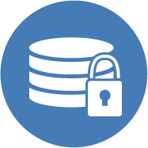
Contents
Mandates and Data Management Plans
File Naming and Metadata
Sharing, Storage, and Security

Slide 3
Mandates and DMPs

Slide 4
Mandates
NIH: 2003 – Data Sharing Plans
NSF: 2011 – Data Management Plans (DMP)
OSTP: 2013 – Increasing the Access to the Results of Federally Funded Scientific Research
NEH: 2014 – Office of Digital Humanities
Notes:
NIH required data sharing in 2003 and sharing publications in 2005. Revised policy in 2008. This may be old news to some departments - so if your department does lots of NIH, tweak appropriatelly.

Slide 5
OSTP
“The Administration is committed to
ensuring that, to the greatest extent and with the fewest constraints possible . . . The direct results of federally funded scientific research are made available to and useful for the public, industry, and the scientific community.”
- John P. Holdren
Director, White House OSTP
Feb 22, 2013

Slide 6
Agencies Responding to DMP
Agriculture (USDA)
Commerce (DOC)
Nat’l Oceanic & Atmospheric Admin (NOAA)
Defense (DoD)
Education (ED)
Energy (DOE)
Health and Human Services (DHHS)
Agency for Healthcare Research & Quality (AHRQ)
Office of Asst Sec for Preparedness & Response (ASPR)
Centers for Disease Control & Prevention (CDC)
Food and Drug Administration (FDA)
Nat’l Institutes of Health (NIH)
Homeland Security (DHS)
Interior (DOI)
Transportation (DOT)
Veterans Affairs (VA)
Environmental Protection Agency (EPA)
Nat’l Aeronautics & Space Admin (NASA)
National Institute of Standards and Tech (NIST)
Nat’l Science Foundation (NSF)
Office of the Director of Nat’l Intelligence (ODNI)
Smithsonian Institution (SI)
U.S. Agency for Int’l Development (USAID)

Slide 7
Why Create a DMP?
There are many benefits to managing and sharing your data:
Find and understand your data when you need to use it
Continuity when project staff leave or new researchers join
Avoid unnecessary duplication e.g. re-collecting or reworking data
Data underlying publications are maintained, allowing for validation of results
Data sharing leads to more collaboration and advances research
Your research is more visible and has greater impact
Other researchers can cite your data so you gain credit
Taken from http://www.dcc.ac.uk/resources/how-guides/develop-data-plan#Why%20develop

Slide 8
What’s in a DMP
Data types and formats
Metadata
Storage and Backups
Intellectual property and usage rights
Archiving and preservation
Ethics and Privacy
Budget
Responsibility

Slide 9
DMP Tool
Go to the tool

Slide 10
File Naming and Metadata

Slide 11
How do you currently name files?

Slide 12
File Naming Best Practices
Context
Short+
No Generics
Consistency
Documentation

Slide 13
Metadata: a Definition
Unstructured Data
Structured Data
There was a study put out by Dr. Gary Bradshaw from the University of Nebraska Medical Center in 1982 called “Growth of Rodent Kidney Cells in Serum Media and the Effect of Viral Transformation on Growth”. It concerns the cytology of kidney cells.
Title | Growth of Rodent Kidney Cells in Serum Media and the Effect of Viral Transformation on Growth
Author | Gary Bradshaw
Date | 1982
Publisher | University of Nebraska Medical Center
Subject | Kidney-Cytology

Slide 14
Why Create Metadata?

Slide 15
File Formats
Use file formats that will likely be readable in the future
The DMP Tool recommends formats that are:
Non-proprietary
Open, with documented standards
In common usage by the research community
Using standard character encodings (i.e., ASCII, UTF-8)
Uncompressed (space permitting)

Slide 16
Sharing, Storage, and Security

Slide 17
Sharing Your Data
Why?
It is required (publisher, government)
It is a good thing (allows your data to be used to answer new questions)
It supports a more open research environment
It creates more exposure to your papers that are based on your research

Slide 18
Where to Share
Required by government:
Check agency for specific guidelines, if available
For example, NIH provides link to recommended repositories
Evaluate long-term security of archive and how easily other in your field can discover your data
Discipline specific (GenBank, ICPSR)
Institutional (DigitalCommons)

Slide 19
How to Find a Repository
Searchable lists
Registry of Research Data Repositories:
Re3data.org

Slide 20
Security
This slide information is coming from
Monica

Slide 21
Evaluating Data Sharing Repository
How will service sustain self?
Long term plan for caring for data?
How will service maximize discovery?
Provide DOI, citation, version control
Sensitive Data, experience with securing and sharing this type of data?

Slide 22
Potential Fees Associated with Deposits
Start planning which depository to use
when develop data management plan
Determine if you will do all deposit or pay someone else
Data deposit fees can be written into grant funding
Tools are available to help you

Slide 23
Data with Risk
Direct Identifiers
Addresses, zip codes
Phone numbers
Indirect Identifiers
Exact dates (birth/death/marriage)
Income
Geographic Data (e.g. county)

Slide 24
Does openICPSR accept and disseminate restricted-use data?
The deposit of sensitive data or data with
disclosure risk (restricted-use) is similar to the deposit of non-sensitive data except that the depositor will indicate that the data should be for restricted-use only
Dissemination of restricted-use data is through ICPSR’s virtual data enclave; in this environment, data never leaves the secure server and analysis takes place in the virtual space
Analysts desiring to access the data will need to apply for the data and will pay an access fee

Slide 25
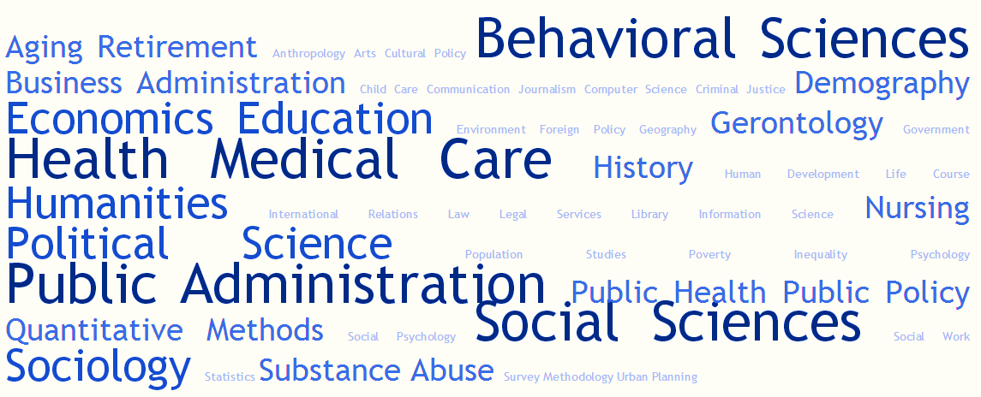
Note
openICPSR accepts research data from a wide array of disciplines/fields, but not all

Slide 26
Who Might Use openICPSR?
Researchers required to share data freely with the public to comply with grant/contract requirements
Authors required to share data for replication purposes to comply with journal requirements
Researchers required to share sensitive data or data with disclosure risk with the public from a secure digital environment
Researchers, including students, who want to share data publicly as good practice or for the purposes of replication

Slide 27
Questions?

Slide 28
Questions?
researchdata@usu.edu

