Slide 1


Welcome to

Slide 2
Noon-1:30pm
Library 101
NOVEMBER 9
Increase your pool of potential grad students
DECEMBER 7
Support students who struggle with mental
health issues
JANUARY 18
Mentor students in a growing lab
FEBRUARY 15
Discover opportunities in interdisciplinary graduate training
MARCH 22
Find participants for
your research study

Slide 3
TODAY:
Open Access to Data: What do I need to know?

Slide 4
Background
Data Management Plans
Metadata Details
Metadata Records
Workshop

Slide 5
Background

Slide 6

“Open Access” Conversation Begins
Office of Science and Technology Memorandum
February 22, 2013

Slide 7
“Open Access” Conversation Begins
  Digitally formatted scientific data should be stored and publicly accessible to search, retrieve, and analyze.

Slide 8
Why open access?
Re-use
Access
Impact
Notes:
Re-use through preservation and broader public access maximize the impact and accountability of the Federal research investment.

Slide 9
Who must comply?
  All agencies with more than $100M in R&D expenditures must draft policy.

Slide 10
What are digital data?
Digitally recorded material necessary to validate research findings and publications

Slide 11
What digital data are NOT?
Laboratory notebooks
Preliminary analyses
Drafts of scientific papers
Plans for future research
Peer review reports
Communications with colleagues
Physical objects (samples/specimens)

Slide 12
What are the major challenges?
  Must provide access without charge
  No “expiration date” for public access to data
  Mandate is largely unfunded
  Subject to audit
  Real consequences for non-compliance for the institution and PI
Notes:
Data policies for most agencies still under development, but the general framework is set

Slide 13
Utah State University response
Library
RGS
    Data Services Coordinator
    Metadata Specialist
    Associate VPR
    Research Development Director
    Sponsored Programs Director
    Programmer

Slide 14
Oh good, more compliance rules…
DMP
Digital Commons record
Data Archiving
    Sets the contract for contract with federal sponsor
    Provides roadmap for public access, retrieval, and analysis.
    Ensures public access through USU’s institutional repository.
Notes:
Said: RGS will carry as much of this new compliance burden as it can, and give you support for the parts we need you to carry:

Slide 15
Data Management Plans

Slide 16
Directly from NSF
Any proposal without a good DMP was placed in the "no further consideration" pile immediately.

Slide 17
Essential Elements of a DMP
Types of data produced
Data and metadata standards
Policies for access and sharing
Policies for reuse
Plans for archiving and preservation
Roles and responsibilities

Slide 18
Types of Data Produced
Describe the data you will collect, reuse, or produce
1
What is the format or file type?
2
How large are the files?
3
How many files?

Slide 19
Types of Data Produced
Describe how you will collect and process the data
1
What equipment will be used?
2
Is there required processing?
3
Are there quality assurance and control guidelines?

Slide 20
Types of Data Produced
Describe how data will be stored during the research project
1
Where will it be located?
2
What are the backup plans?

Slide 21
Data and Metadata Standards
1
Does the discipline use a specific repository with a specific metadata standard?
2
How will you describe the data to make it re-usable?

Slide 22
Policies for Access and Sharing
1
Can data be used right away or will there be an embargo period?
2
Does data require special software to use?
3
How will people get access to your data?
4
Are any data restricted?

Slide 23
Policies for Reuse
1
Will permission be required for data use?
2
Who is likely to want to use the data?
3
What is the intended future use of the data?

Slide 24
Plans for Archiving and Preservation
1
What are the long-term plans for the data?
2
What repository will be used for storage and does it have a backup plan?
3
Which data will you deposit or preserve?
4
What metadata documents will you include?
Notes:
Backup plan is referenced in Types of data produced

Slide 25
Roles and Responsibilities
1
Who is responsible for implementing the DMP?
2
How will you demonstrate you have adhered to the DMP?

Slide 26
Resources to help write a DMP
DMP Tool
USU Library
Templates for major funders
Data management LibGuide
Data management resources
Research librarians
Sample DMPs

Slide 27
Metadata details

Slide 28
Proposal creation and submission
Kuali →Primary Master Record
Data Management Plan
Library creates records in Digital Commons Duplicate attached to Kuali record
Award setup
Award period
Updated information to Library
Library verifies data, creates records
Award closeout
Sponsored Programs continues to notify PI
for 2 years or until all data deposited
Notes:
4 slides (Only
1. Title to Jeff’s proposal

Slide 29
Kuali captures basic elements of future Primary Metadata Record
Proposal creation and submission
Award setup
Award period
Award closeout
Notes:
4 slides (Only
1. Title to Jeff’s proposal

Slide 30
PI notified of requirements
Data Management Plan and/or Primary Metadata document sent to Library
Library creates records in Digital Commons
Duplicate record attached to Kuali record
Proposal creation and submission
Award setup
Award period
Award closeout
Notes:
4 slides (Only
1. Title to Jeff’s proposal

Slide 31
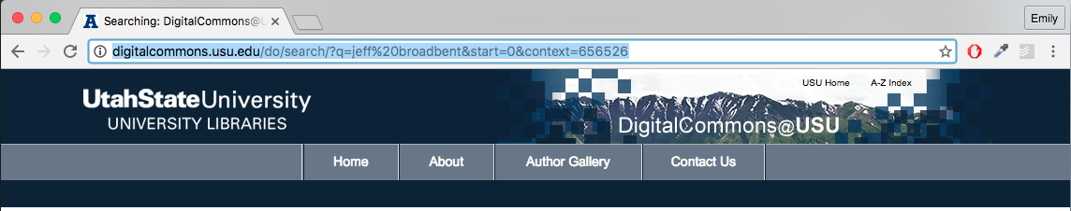
Notes:
Example of what a Master Data Record looks like in Digital Commons
The Data Management Plan becomes available through the Download option
Primary Metadata document accessible through additional files

Slide 32
Proposal creation and submission
Award setup
PI notified to update primary metadata record
Send updated plan to Library
Library verifies data, creates records
Award period
Award closeout
Notes:
4 slides (Only
1. Title to Jeff’s proposal

Slide 33
Notes:
Example of Dataset Record
Location of datasets verified
Metadata records created
Link to dataset provided

Slide 34
Proposal creation and submission
Award setup
Award period
PI notified, even after closeout, for two years until all data deposited
Award closeout
Notes:
4 slides (Only
1. Title to Jeff’s proposal

Slide 35
Primary Metadata Document
Sponsored Programs
PI
Library
    Creates document from Kuali data
    Updates document every year with publication and data deposit info
    Verifies data deposits and creates records in Digital Commons

Slide 36
Constant Data (from Kuali)
1st Author/Researcher listed | Jeff Broadbent
Title/Name assigned to grant | Characterizing Stress Responses of Industrial Strains of Bifidobacteria and Their Use for Extending the Survival of Bifidobacteria in Foods
Place where data originated | Logan, UT
Primary institution name | Utah State University
Project start and stop dates | Sep 1 2006-Aug 31, 2010
Granting Agency, grant award number | USDA 2006-35503-17194
Subject of research data | food products, bacteria, quality maintenance in soring and marketing food products, bifdobacterium, probiotic, stress response
Agency Progress and Final Report Location (URL) | http://www.reeis.usda.gov/web/crisprojectpages/0206831-characterizing-stress-responses-of-industrial-strains-of-bifidobacteria-and-their-use-for-extending-the-survival-of-bifidobacteria-in-foods.html
Publications
Publication Citations (repeatable) | Oberg, T. S., Steele, J. L., Ingham, S. C., Smeianov, V. V., Briczinski, E. P., Abdalla, A., & Broadbent, J. R. (2011). Intrinsic and inducible resistance to hydrogen peroxide in Bifidobacterium species. Journal of Industrial Microbiology & Biotechnology, 38(12), 1947–1953. http://doi.org/10.1007/s10295-011-0983-y
 | Oberg, T. S., Ward, R. E., Steele, J. L., & Broadbent, J. R. (2015). Transcriptome analysis of Bifidobacterium longum strains that show a differential response to hydrogen peroxide stress. Journal of Biotechnology, 212, 58–64. http://doi.org/10.1016/j.jbiotec.2015.06.405
Data Deposits (or Other Associated Data)
Title/Name assigned to data set | Expression data from Bifidobacterium longum strains exposed to hydrogen peroxide stress
Description (100 word limit) | Stress survival tactics in bacteria utilize the up- and down-regulation of stress response genes. In bacterial that lack classical stress response genes for oxidative stress, other….
URL or DOI for location of dataset | http://www.ncbi.nlm.nih.gov/geo/query/acc.cgi?acc=GSE44709
Year of publication/deposit | 2013
File type (ex. Txt,XML,PDF) | TXT, XML
Is a special program or software needed to access this data ? If yes what is it?
Link to associated Journal Article (repeatable) | http://doi.org/10.1016/j.jbiotec.2015.06.405

Slide 37
Notes:
Online Catalog Record

Slide 38
  Create record if none exists
  Add URL from agency repository
Notes:
Publications
Add funder information to existing records;

Slide 39
Metadata
Data about your data

Slide 40
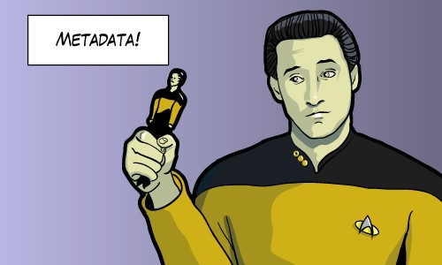

Slide 41
Metadata
Unstructured data
Structured data
      There was a study put out by Dr. Gary Bradshaw from the University of Nebraska Medical Center in 1982 called “ Growth of Rodent Kidney Cells in Serum Media and the Effect of Viral Transformation On Growth Factor Requirements for Multiplication”. It concerns the cytology of kidney cells.
      Title
Growth of Rodent Kidney Cells in Serum Media and the Effect of Viral Transformation on Growth Factor Requirements for Multiplication
      Author
Gary Bradshaw
      Date
1992
      Publisher
University of Nebraska Medical Center
      Subject
Kidney- Cytology
Notes:
Said: RGS will carry as much of this new compliance burden as it can, and give you support for the parts we need you to carry:

Slide 42
Why create metadata?
  Increase Interoperability, discoverability, filterability
  Organization
  Consistency
  Sharing
  Replicate research data
Notes:
Data policies for most agencies still under development, but the general framework is set

Slide 43
Answer these questions
  Why was the data created?
  What processes were used to create the data?
  When was the data last updated?
  Who created the data?
  What fields are present and what do the values of those fields mean?
  Who do I contact about getting more information about the data?
  How do I obtain a hard copy of the data?
  Are there any limitations to the data?
Notes:
Data policies for most agencies still under development, but the general framework is set

Slide 44
Tips and best practices
  Organize your information
  Write your metadata using a tool (if available)
  Review your records for accuracy/completeness
  Have someone else review your records
  Revise then review again
Notes:
Data policies for most agencies still under development, but the general framework is set

Slide 45
Tips and best practices
  Don’t use jargon or acronyms
  Avoid special characters
  Titles are important
    Who, what, where, when and scale
Notes:
Data policies for most agencies still under development, but the general framework is set

Slide 46
Example
Rivers
vs
Greater Yellowstone Rivers: 1:126,700 U.S Forest Service Visitor Maps (1961-1983)

Slide 47
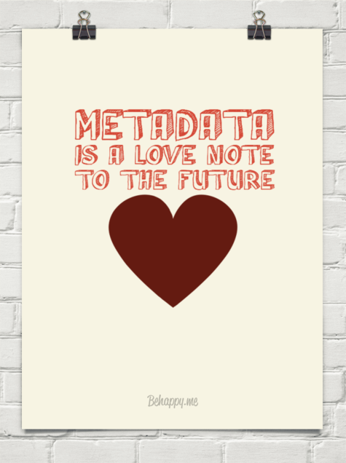
Metadata is created for others…
  Computers (Google)
  For colleagues to find
  For researchers to use
  For the university
  For the library to help accessibility
  For your future self

Slide 48
Metadata Timeline
Notes:
https://prezi.com/ohlbld-btija/metadata-for-research-data-usu/

Slide 49
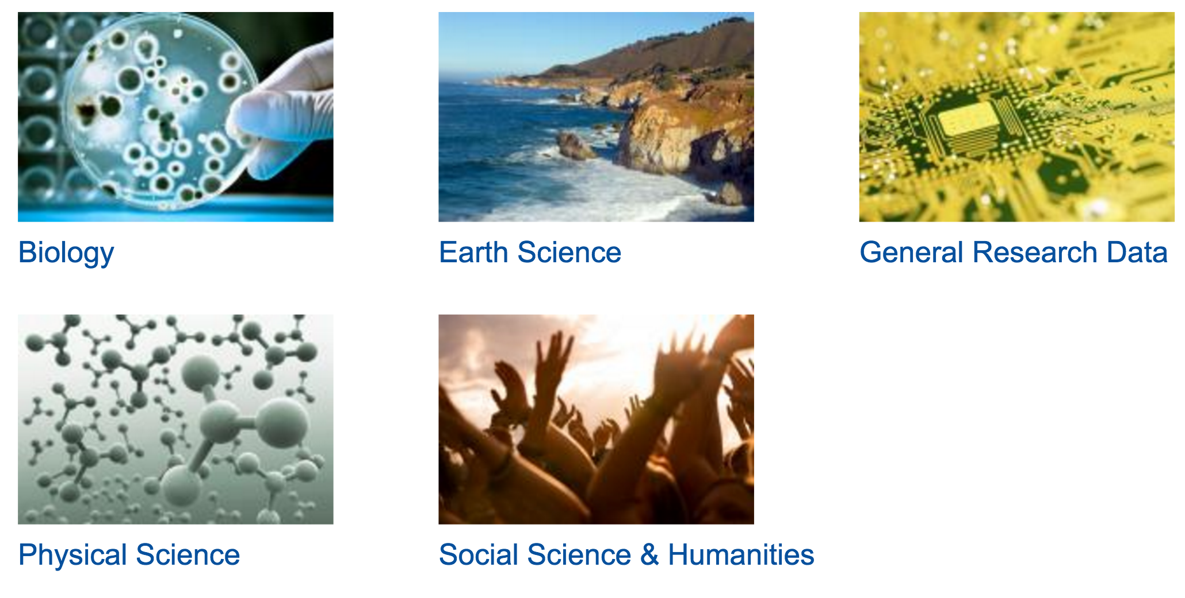
Disciplinary Metadata
  Digital Curation Centre’s list of subject specific metadata schemas
http://www.dcc.ac.uk/resources/metadata-standards
Notes:
http://www.dcc.ac.uk/resources/metadata-standards

Slide 50
Workshop

Slide 51
NOVEMBER 9
Increase your pool of potential
graduate students
Noon-1:30pm | Library 101

