Slide 1


Welcome to GrTS
Welcome to
How can I manage and store data effectively?
How can I improve my teaching techniques?

Slide 2

Coming up:
Next month’s GrTS
How should I engage an audience when presenting research?
Wednesday, November 16
12:00 to 1:30 p.m.
Library 101
RSVP at
rgs.usu.edu/grts/rsvp
Graduate Student Social
Tuesday, November 15
6:00 to 8:00 p.m.
Hosted by Agriculture & Applied Sciences
Logan Country Club
RSVP at
rgs.usu.edu/graduateschool/
graduate-student-social

Slide 3
Today:
Open Access to Data:
What’s it all about, and how does it affect me?

Slide 4
Today:
Background
Thinking About Your Data
Metadata
Data Access and Sharing
Workshop

Slide 5
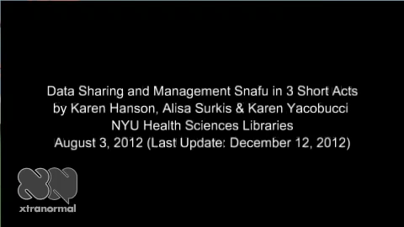
Background

Slide 6

“Open Access” Conversation Begins
Office of Science and Technology Memorandum
February 22, 2013
Digitally formatted scientific data should be stored and publicly accessible to search, retrieve, and analyze.

Slide 7
Why open access?
Publically Funded | Additional Analyses | Increased Impact

Slide 8
Who must comply?
All agencies with more than $100M in R&D expenditures must draft policy.

Slide 9
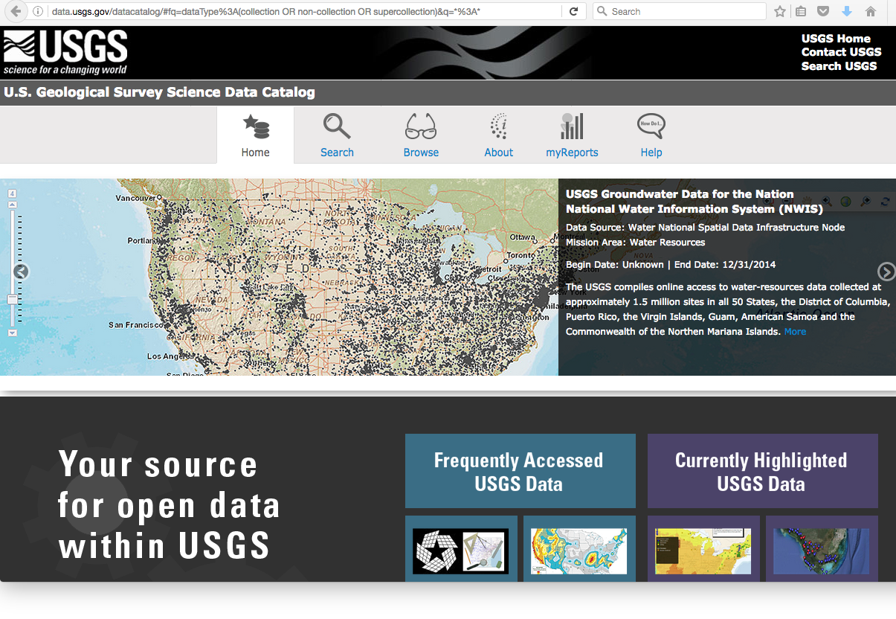
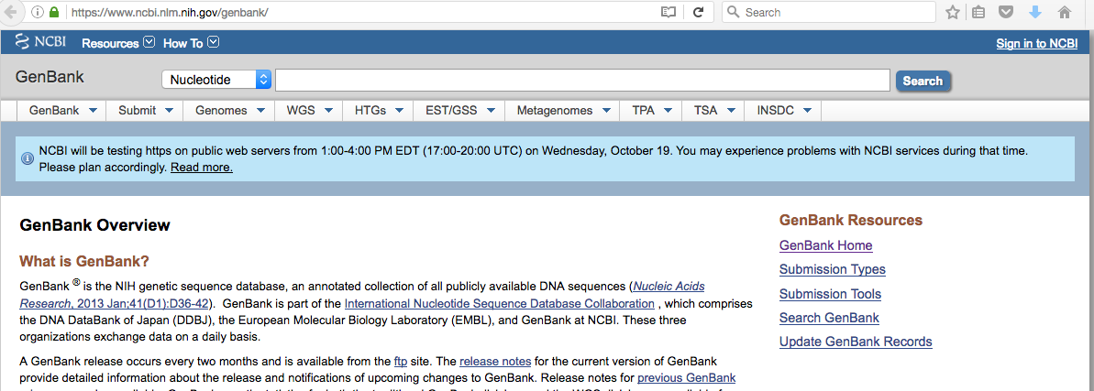
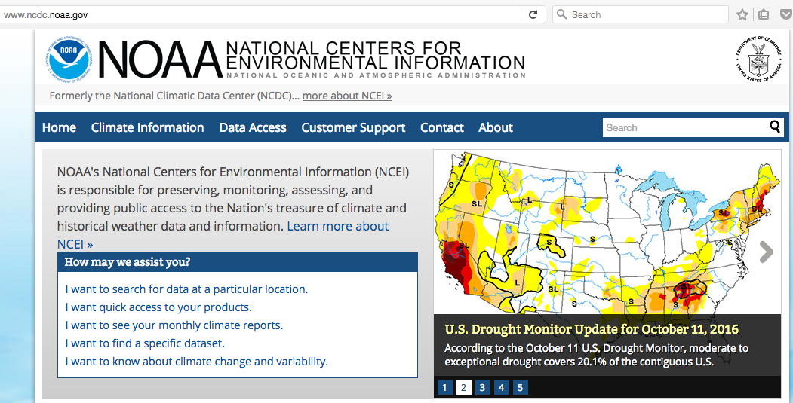

Slide 10
What are digital data NOT?
Laboratory notebooks
Preliminary analyses
Drafts of scientific papers
Plans for future research
Peer review reports
Communications with colleagues
Physical objects (samples/specimens)

Slide 11
What are digital data?
Digitally recorded material necessary to validate research findings and publications

Slide 12
Welcome to GrTS
Thinking About Your Data
How can I improve my teaching techniques?
Planning ahead

Slide 13
Data collection:
How will you collect and process your data?
What equipment will be used?
Is there required processing?
Are there quality assurance and control guidelines?

Slide 14
Data formats:
What format(s) will your data have?
What is the format or file type?
How large are the files?
How many files?

Slide 15
Data file names:
Type of data: % cover, melting point, lat/long, growth rate,…
Raw data, summarized data?
Date: YYYYMMDD format will sort chronologically
How should you name your files so that they will be recognizable?

Slide 16
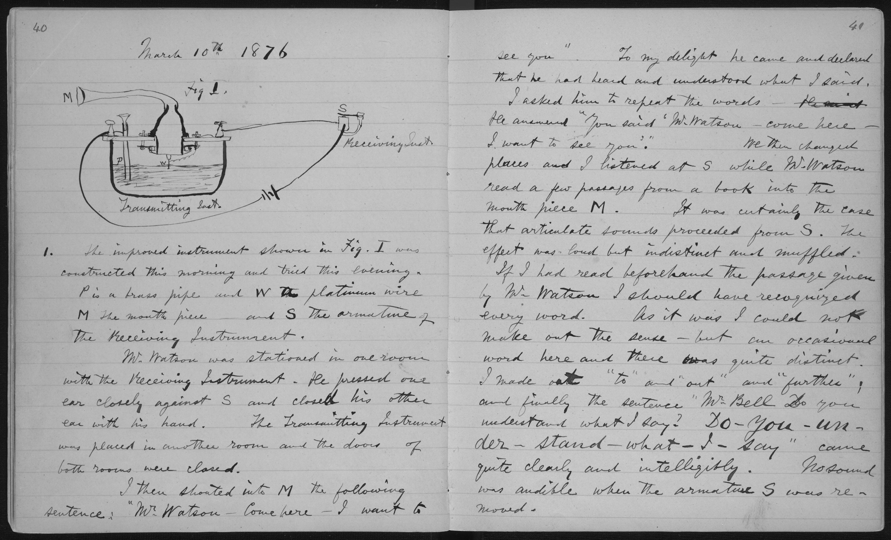
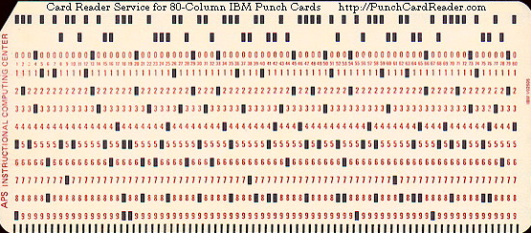
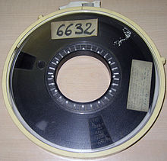
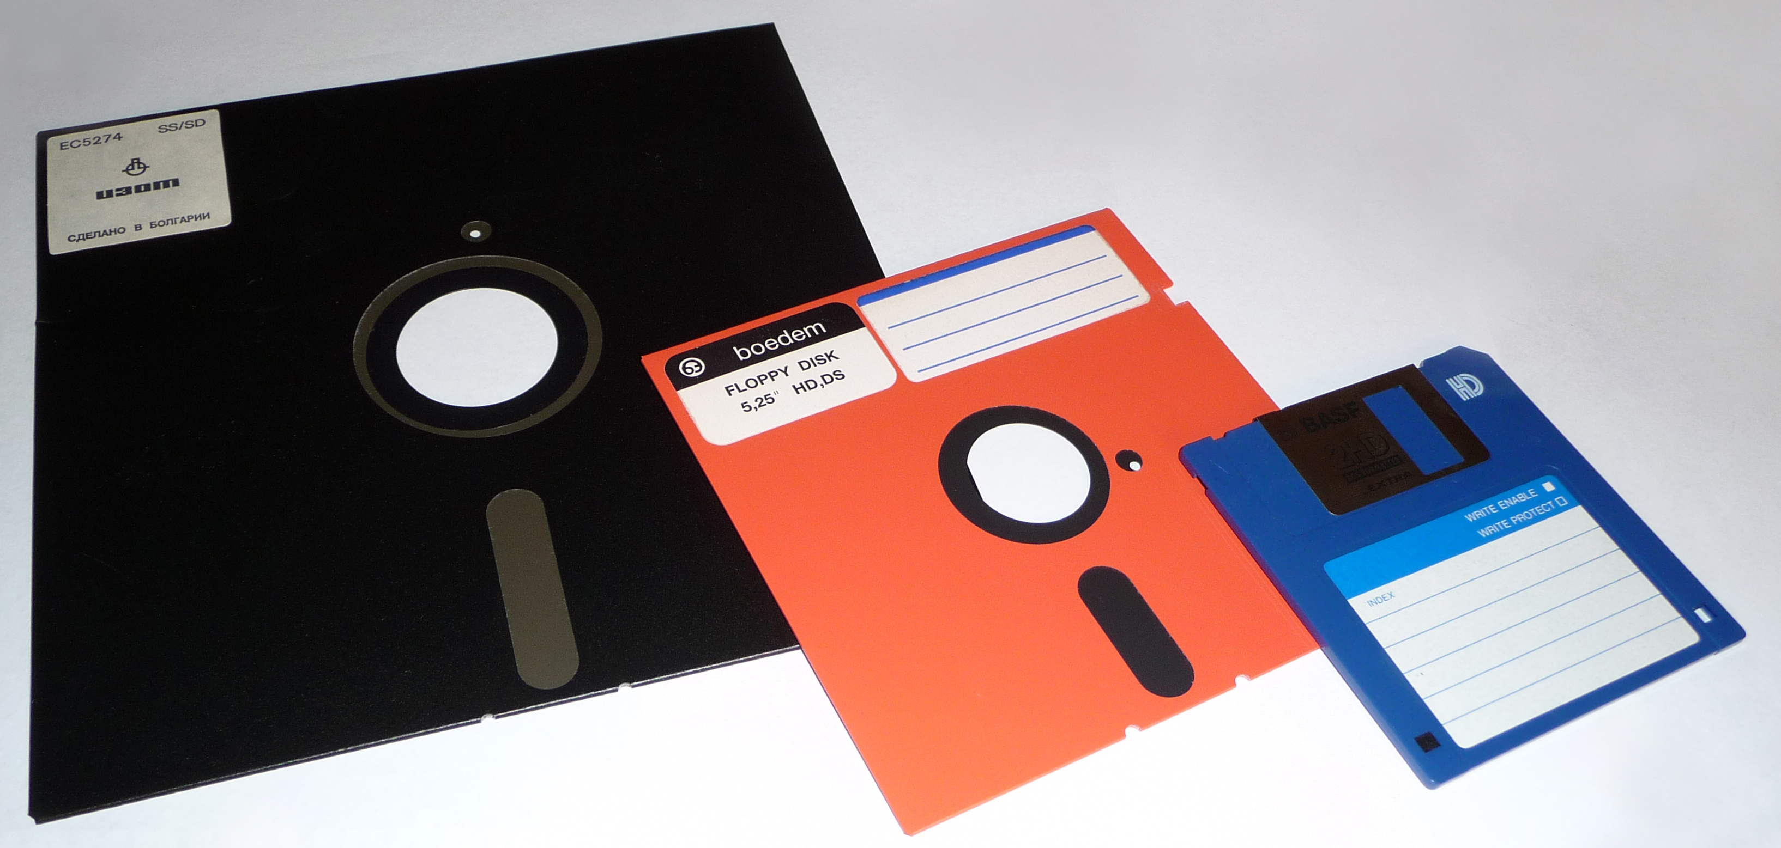
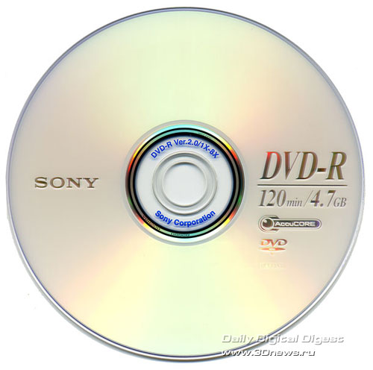
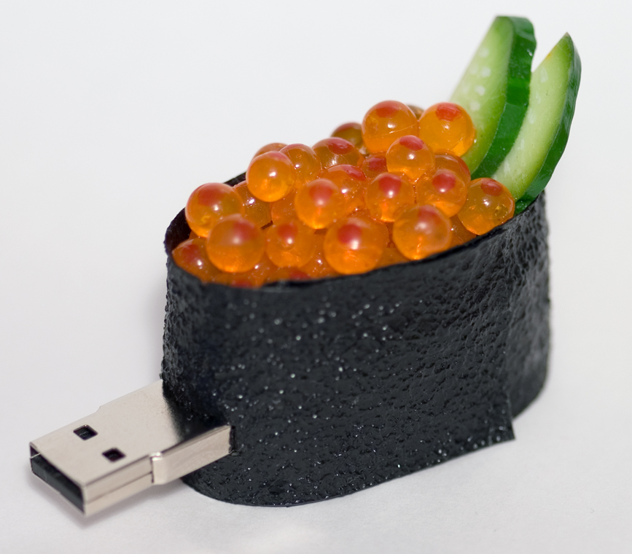
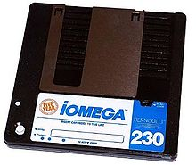
Data storage:

Slide 17
Data storage:
How will you store your data while you are doing your research?
Where will it be located?
What are the backup plans?

Slide 18
Welcome to GrTS
Metadata
How can I improve my teaching techniques?
Data about your data

Slide 19
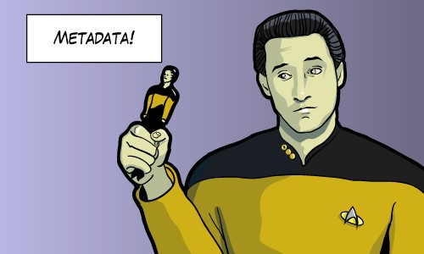

Slide 20
Metadata:
Unstructured data:
There was a study put out by Dr. Gary Bradshaw from the University of Nebraska Medical Center in 1982 called “Growth of Rodent Kidney Cells in Serum-free Media and the Effect of Viral Transformation On Growth Factor Requirements for Multiplication.” It concerns the cytology of kidney cells.
Structured data:
Title | Growth of Rodent Kidney Cells in Serum-free Media and the Effect of Viral Transformation On Growth Factor Requirements for Multiplication
Author | Gary Bradshaw
Date | 1982
Publisher | University of Nebraska Medical Center
Subject | Kidney-Cytology

Slide 21
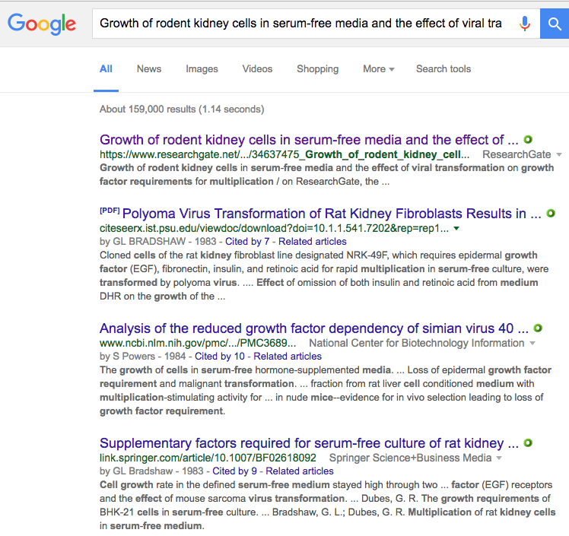
Why create metadata?
Discoverability (by Google, etc.)
Interoperability
Organization
Consistency
Sharing
Replicate research data

Slide 22
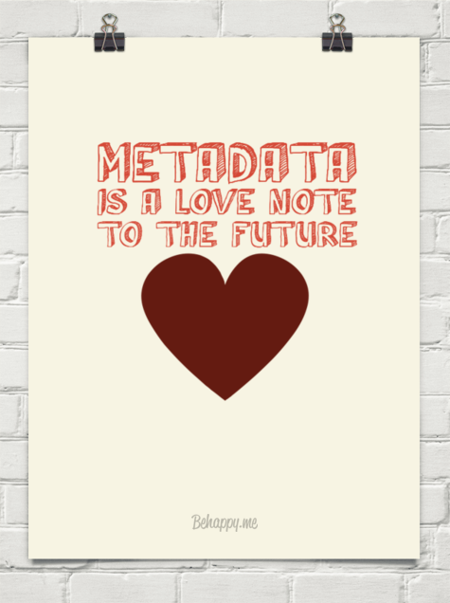
Metadata is created for others…
Computers (Google)
For colleagues to find
For researchers to use
For the university
For the library, to help accessibility
For your future self

Slide 24
Answer these questions:
Why were the data created?
What processes were used to create the data?
When were the data last updated?
Who created the data?
What fields are present and what do the values of those fields mean?
Who do I contact about getting more information about the data?
How do I obtain a hard copy of the data?
Are there any limitations to the data?

Slide 25
Tips and best practices:
Organize your information
Write your metadata using a tool (if available)
Review your records for accuracy/completeness
Have someone else review your records
Revise then review again

Slide 26
Tips and best practices:
Don’t use jargon or acronyms
Avoid special characters
Titles are important
  Who, what, where, when, and scale

Slide 27
Example:
Greater Yellowstone Rivers: 1:1 26,700 U.S. Forest Service Visitor Maps (1961-1983)
Rivers
VS

Slide 28
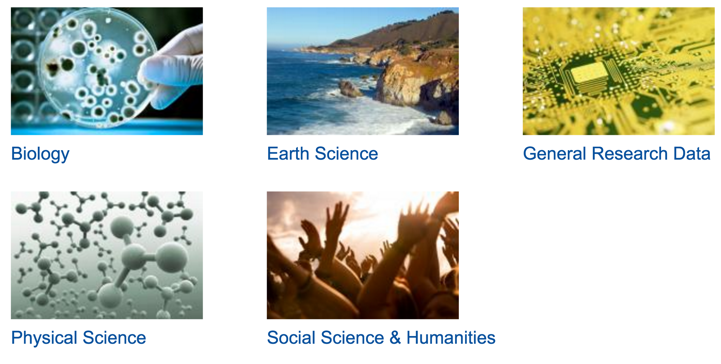
Disciplinary Metadata:
Digital Curation Centre’s list of subject specific metadata schemas
http://www.dcc.ac.uk/resources/metadata-standards

Slide 29
Welcome to GrTS
Data Access & Sharing
How can I improve my teaching techniques?
Who gets to read your love note?

Slide 30
Why share data?
For the benefit of the public
For the benefit of the research sponsor
For the benefit of the research community
For the benefit of the researcher

Slide 31
Considerations: Data and metadata standards
Does the discipline use a specific repository with a specific metadata standard?
How will you describe the data to make it reusable?

Slide 32
Considerations: Accessibility
Can data be used right away or will there be an embargo period?
Do data require special software to use?
How will people get to access your data?
Are there any data restricted?

Slide 33
Considerations: Reuse
Will permission be required for data use?
Who is likely to want to use the data?
What is the intended future use of the data?

Slide 34
Considerations: Archiving and preservation
What are the long-term plans for the data?
What repository will be used for storage and does it have a backup plan?
Which data will you deposit or preserve?
What metadata documents will you include?

Slide 35
In summary:
Managing digital data is an important part of the research process.
When planning how to store data, consider questions such as how you will collect the data, what format it will take, and how you will back it up.
Use metadata to make your data more accessible.
Sharing data effectively benefits not only you, but your sponsor, the research community, and the public.

Slide 36
Coming up:
Next month’s GrTS
How should I engage an audience when presenting research?
Wednesday, November 16
12:00 to 1:30 p.m.
Library 101
RSVP at
rgs.usu.edu/grts/rsvp
Graduate Student Social
Tuesday, November 15
6:00 to 8:00 p.m.
Logan Country Club
RSVP at
rgs.usu.edu/graduateschool/
graduate-student-social

Slide 37
Welcome to GrTS
Workshop
How can I improve my teaching techniques?

Slide 38
Metadata Standards:
Dublin Core Elements:
Darwin Core Elements:
Title
Date
Creator
Contributor
Description
Subject
Type
Format
Publisher
Identifier
Source
Language
Relation
Coverage
Rights
Occurrence
Organism
Material Sample
LivingSpecimen
PreservedSpecimen
Event
HumanObservation
MachineObservation
Location
Identification
Taxon
MeasurementOrFact
ResourceRelationship

Slide 39
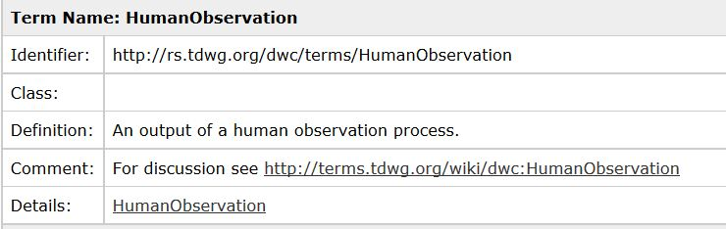
Metadata Standards:

Slide 40
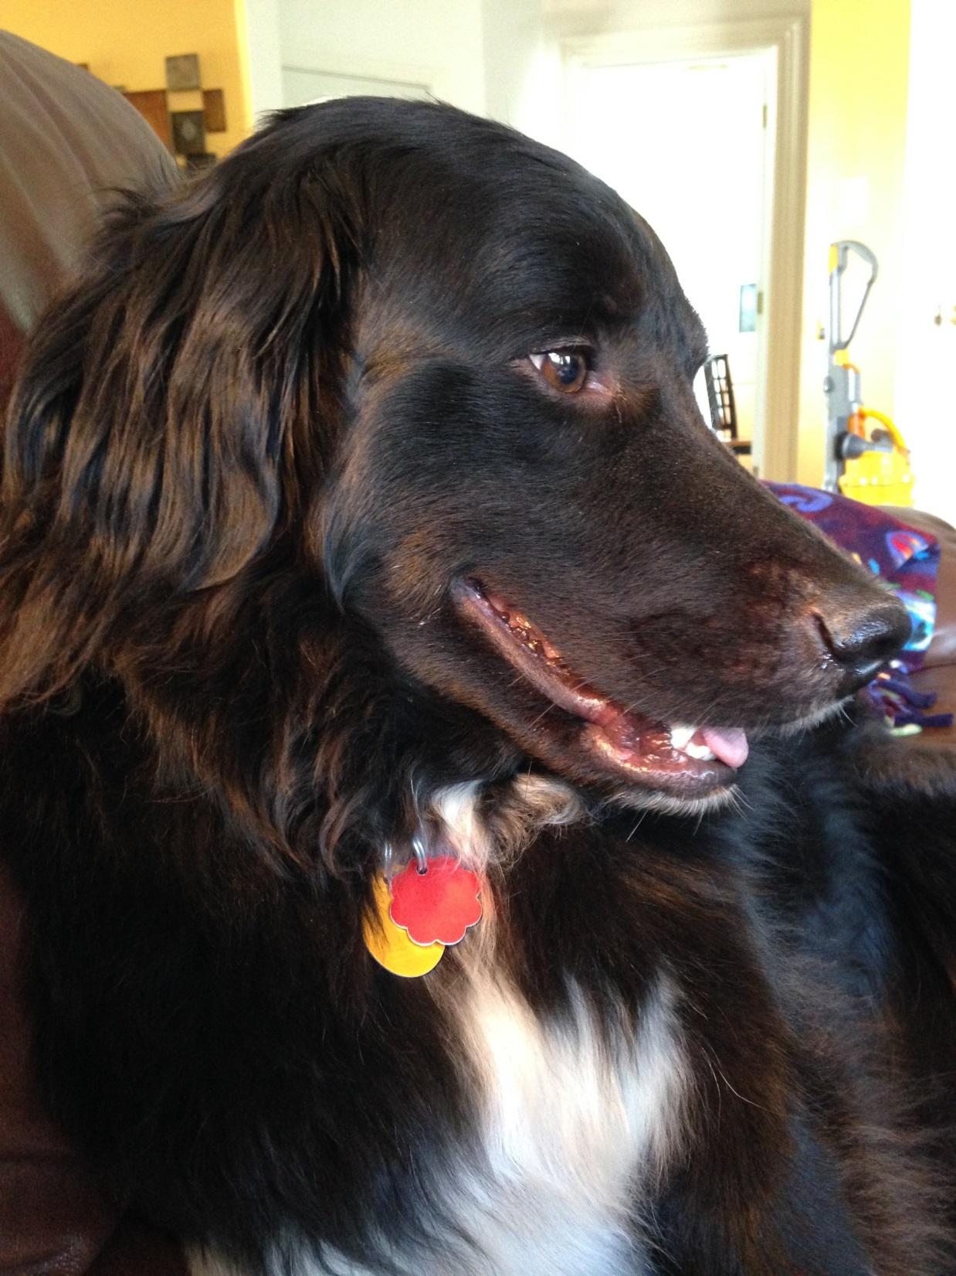
Hendricks

Slide 41
Thank you for coming!
Plan ahead! Contact:
Betty.Rozum@usu.edu
Andrea.Payant@usu.edu

Slide 43
Resources to help write a DMP:
DMP Tool:
Templates for major funders
Data management resources
Sample DMPs
USU Library:
Data management LibGuide
Research librarians

Slide 44
Plan ahead:
DMP:
Betty Rozum
  Betty.Rozum@usu.edu
Data management and metadata:
Andrea Payant
  Andrea.Payant@usu.edu

Slide 45
Welcome to GrTS
Metadata Details
How can I improve my teaching techniques?

Slide 46
Proposal creation and submission
Kuali →Primary Master Record
Data Management Plan
Library creates records in Digital Commons Duplicate attached to Kuali record
Award setup
Updated information to Library
Library verifies data, creates records
Award period
Sponsored Programs continues to notify PI
for 2 years or until all data deposited
Award closeout

Slide 47
Proposal creation and submission
Kuali captures basic elements of future Primary Metadata Record
Award setup
Award period
Award closeout

Slide 48
Proposal creation and submission
PI notified of requirements
Data Management Plan and/or Primary Metadata document sent to Library
Library creates records in Digital Commons
Duplicate record attached to Kuali record
Award setup
Award period
Award closeout

Slide 49
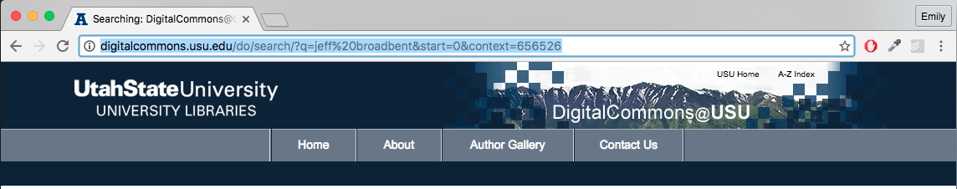

Slide 50
Proposal creation and submission
Award setup
PI notified to update primary metadata record
Send updated plan to Library
Library verifies data, creates records
Award period
Award closeout

Slide 52
Proposal creation and submission
Award setup
Award period
PI notified, even after closeout, for two years until all data deposited
Award closeout

Slide 53
Primary metadata document:
Sponsored Programs
Creates document from Kuali data
PI
Updates document every year with publication and data deposit info
Library
Verifies data deposits and creates records in Digital Commons

Slide 54
Constant Data (from Kuali)
1st Author/Researcher listed | Jeff Broadbent
Title/Name assigned to grant | Characterizing Stress Responses of Industrial Strains of Bifidobacteria and Their Use for Extending the Survival of Bifidobacteria in Foods
Place where data originated | Logan, UT
Primary institution name | Utah State University
Project start and stop dates | Sep 1 2006-Aug 31, 2010
Granting Agency, grant award number | USDA 2006-35503-17194
Subject of research data | food products, bacteria, quality maintenance in soring and marketing food products, bifdobacterium, probiotic, stress response
Agency Progress and Final Report Location (URL) | http://www.reeis.usda.gov/web/crisprojectpages/0206831-characterizing-stress-responses-of-industrial-strains-of-bifidobacteria-and-their-use-for-extending-the-survival-of-bifidobacteria-in-foods.html
Publications
Publication Citations (repeatable) | Oberg, T. S., Steele, J. L., Ingham, S. C., Smeianov, V. V., Briczinski, E. P., Abdalla, A., & Broadbent, J. R. (2011). Intrinsic and inducible resistance to hydrogen peroxide in Bifidobacterium species. Journal of Industrial Microbiology & Biotechnology, 38(12), 1947–1953. http://doi.org/10.1007/s10295-011-0983-y
 | Oberg, T. S., Ward, R. E., Steele, J. L., & Broadbent, J. R. (2015). Transcriptome analysis of Bifidobacterium longum strains that show a differential response to hydrogen peroxide stress. Journal of Biotechnology, 212, 58–64. http://doi.org/10.1016/j.jbiotec.2015.06.405
Data Deposits (or Other Associated Data)
Title/Name assigned to data set | Expression data from Bifidobacterium longum strains exposed to hydrogen peroxide stress
Description (100 word limit) | Stress survival tactics in bacteria utilize the up- and down-regulation of stress response genes. In bacterial that lack classical stress response genes for oxidative stress, other….
URL or DOI for location of dataset | http://www.ncbi.nlm.nih.gov/geo/query/acc.cgi?acc=GSE44709
Year of publication/deposit | 2013
File type (ex. Txt,XML,PDF) | TXT, XML
Is a special program or software needed to access this data ? If yes what is it?
Link to associated Journal Article (repeatable) | http://doi.org/10.1016/j.jbiotec.2015.06.405

Slide 57
Welcome to GrTS
Metadata Timeline
How can I improve my teaching techniques?

Slide 58
What are the major challenges?
Must provide access without charge
Mandate is largely unfunded
No “expiration date” for public access to data
Subject to audit
Real consequences for non-compliance for the institution and PI

Slide 59
Utah State University response:
Library
Data Services Coordinator
Metadata Specialist
RGS
Associate VPR
Research Development Director
Sponsored Programs Director
Programmer

Slide 60
Oh good, more compliance rules…
DMP
Sets the contract for contract with federal sponsor
Digital Commons Record
Provides roadmap for public access and protects USU and you in case of audit
Data Archiving
Creates public access and can be done in USU’s institutional repository

Slide 61
Welcome to GrTS
Data Management Plans
How can I improve my teaching techniques?

Slide 62
Directly from NSF”
Any proposal without a good DMP was placed in the ”no further consideration” pile immediately.

Slide 63
Essential elements of a DMP:
Types of data produced
Data and metadata standards
Policies for access and sharing
Policies for reuse
Plans for archiving and preservation
Roles and responsibilities

Slide 64
Digital data:
Digital Commons - http://digitalcommons.usu.edu/datasets/
Online data repository:
GenBank - https://www.ncbi.nlm.nih.gov/genbank/
NOAA data - http://www.ncdc.noaa.gov/
USGS data - http://data.usgs.gov/datacatalog/

Slide 65
Welcome to GrTS
Background
How can I improve my teaching techniques?

Slide 66
“Open Access” Conversation Begins:
Digitally formatted scientific data should be stored and publicly accessible to search, retrieve, and analyze.

